Slide 1
Elections
By Ilin Bandrov

Slide 2
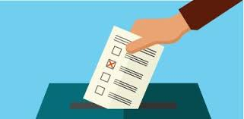
What is an Election
An election is a formal group decision-making process by which a population chooses an individual to hold public office
Elections have been the usual mechanism by which modern representative democracy has operated since the 17th century

Slide 3
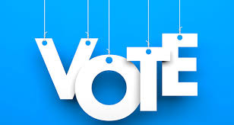
The universal use of elections
The universal use of elections as a tool for selecting representatives in modern representative democracies is in contrast with the practice in the democratic archetype

Slide 4
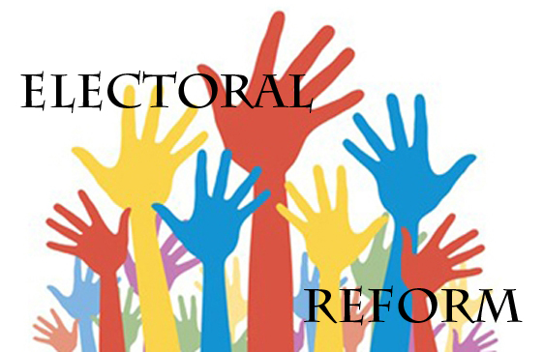
Electoral reform
Electoral reform describes the process of introducing fair electoral systems where they are not in place, or improving the fairness or effectiveness of existing systems
Psephology is the study of results and other statistics relating to elections

Slide 5
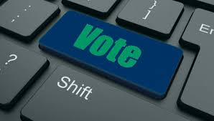
The modern election
The modern "election", which consists of public elections of government officials, didn't emerge until the beginning of the 17th century when the idea of representative government took hold in North America and Europe.

Slide 6
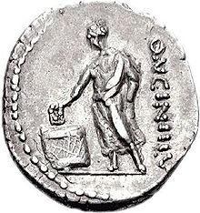
The history of elections
Elections were used as early in history as ancient Greece and ancient Rome, and throughout the Medieval period to select rulers such as the Holy Roman Emperor and the pope

Slide 7
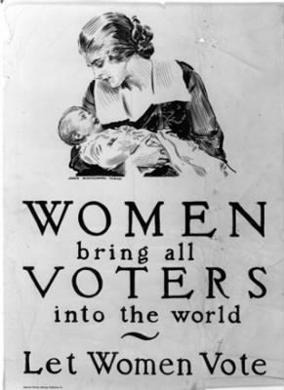
Suffrage
The question of who may vote is a central issue in elections
The electorate does not generally include the entire population
n Australia Aboriginal people were not given the right to vote until 1962 and in 2010 the federal government removed the rights of prisoners to vote
in the European Union, one can vote in municipal elections if one lives in the municipality and is an EU citizen

Slide 8
Nomination
A representative democracy requires a procedure to govern nomination for political office. In many cases, nomination for office is mediated through preselection processes in organized political parties
Non-partisan systems tend to differ from partisan systems as concerns nominations

Slide 9
Electoral systems
Electoral systems are the detailed constitutional arrangements and voting systems that convert the vote into a
The first step is to tally the votes, for which various vote counting systems and ballot types are used political decision
Voting systems then determine the result on the basis of the tally

Slide 10
Scheduling
The nature of democracy is that elected officials are accountable to the people, and they must return to the voters at prescribed intervals to seek their mandate to continue in office
For that reason most democratic constitutions provide that elections are held at fixed regular intervals

Slide 11
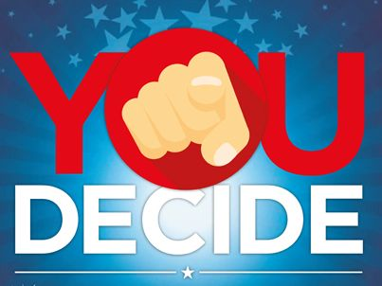
Election campaigns
When elections are called, politicians and their supporters attempt to influence policy by competing directly for the votes of constituents in what are called campaigns
Supporters for a campaign can be either formally organized or loosely affiliated, and frequently utilize campaign advertising

Slide 12
Difficulties with elections
In many countries with weak rule of law, the most common reason why elections do not meet international standards of being "free and fair" is interference from the incumbent government
Dictators may use the powers of the executive to remain in power despite popular opinion in favor of removal

Slide 13
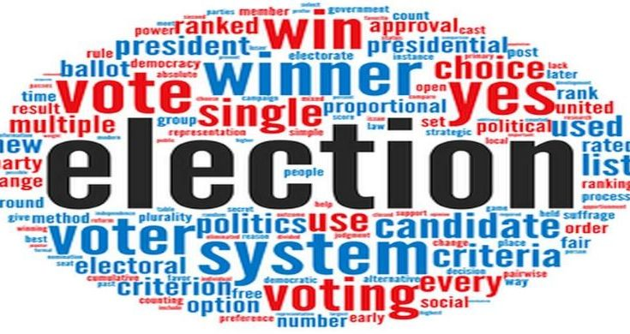
Tampering with the election mechanism
This can include confusing or misleading voters about how to vote, violation of the secret ballot, ballot stuffing, destruction of legitimately cast ballots, voter suppression, voter registration fraud, failure to validate voter residency, fraudulent tabulation of results, and use of physical force or verbal intimation at polling places

